Slide 1
Women Security System
A project to enhance safety for women using technology.

Slide 2




Project
KCA-451
MCA-II YEAR/IV SEMESTER

Slide 3
Introduction
This presentation discusses the increasing concerns regarding women's safety and introduces a mobile application designed to enhance security. The app utilizes Flutter for cross-platform development, enabling a user-friendly and efficient solution for safety.

Slide 4
01
Emergency Contact

Slide 5
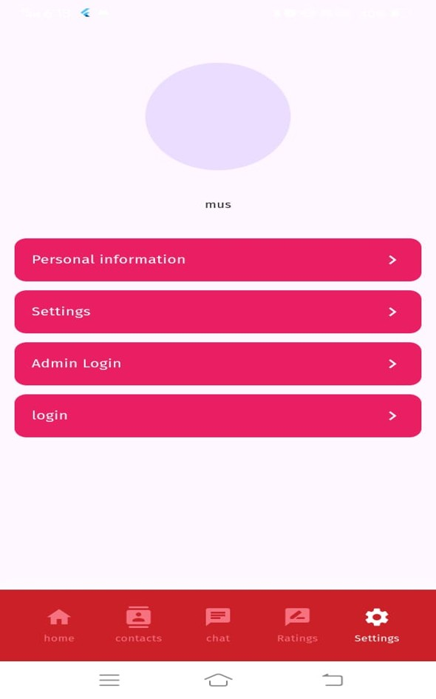
Setup process
The process begins with user registration where they enter their details and emergency contacts. Users can easily choose contacts from their phone to ensure immediate reach during crises.

Slide 6

Contact list management
Users can manage their emergency contact list, adding or removing contacts as needed. This feature ensures that users have up-to-date contacts who can be notified in emergencies.

Slide 7
Notifications and alerts
The system sends automated notifications to the selected contacts during an emergency. Alerts can be customized based on user settings, including text messages and location sharing.

Slide 8
02
Location Tracking

Slide 9
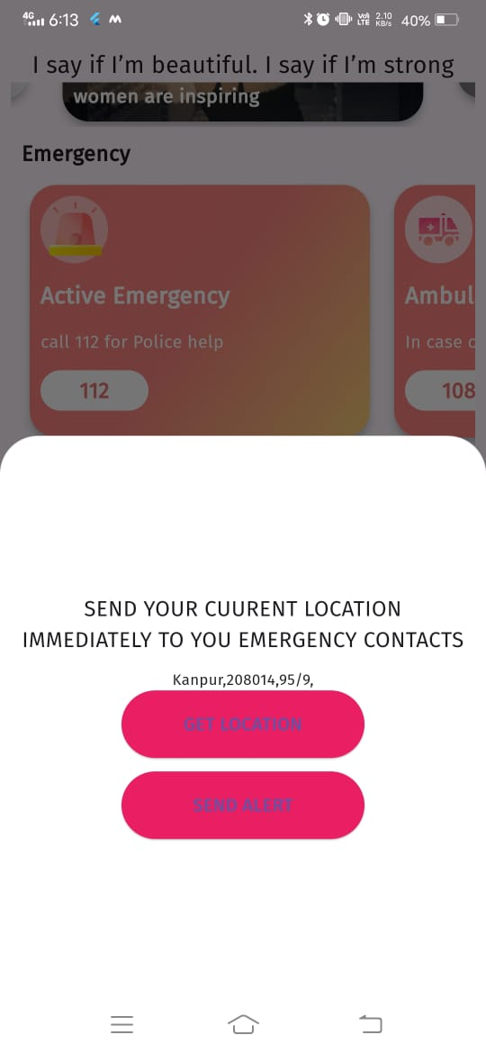
Real-time tracking
Utilizing GPS technology, the app allows users to be tracked in real-time. This feature is vital for ensuring safety, especially in high-risk situations.

Slide 10
Privacy settings
Users have control over their privacy settings, allowing them to choose who can see their location and when. This ensures safety without compromising personal privacy.

Slide 11
03
Police Emergency

Slide 12
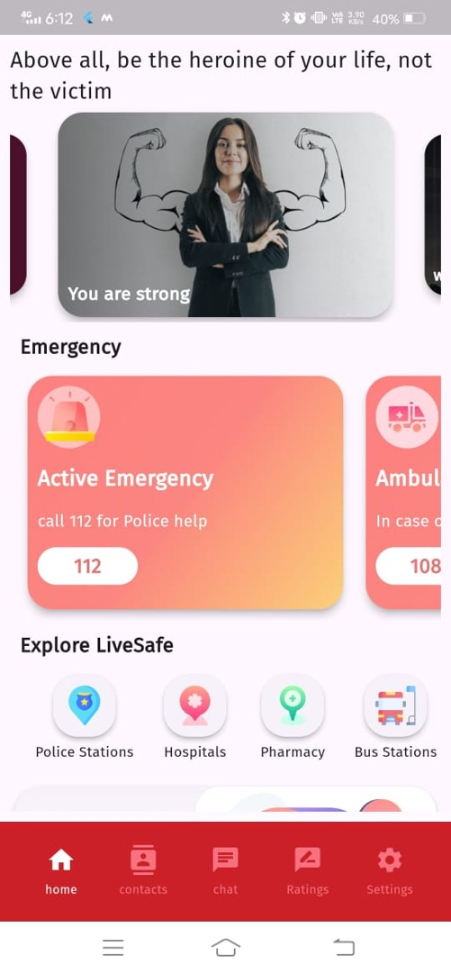
Integration with police systems
The system is designed to interface directly with local police departments, providing them with instant information during emergencies to facilitate a swift response.

Slide 13
04
SOS Alert

Slide 14
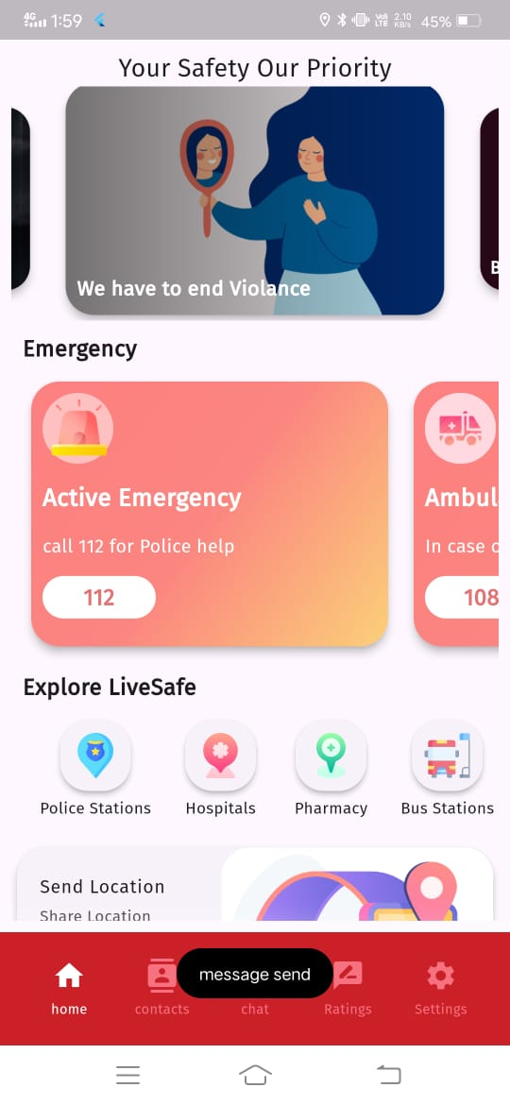
Activation methods
SOS alerts can be activated through various methods such as shaking the device, pressing a dedicated button, or tapping the screen multiple times, ensuring quick access in emergencies.

Slide 15
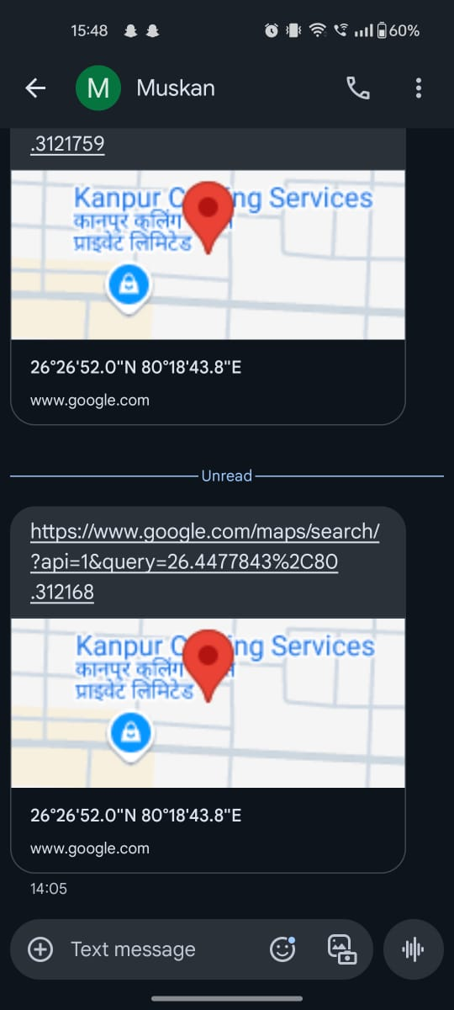
Alert notifications
Once an SOS alert is activated, immediate notifications are sent to pre-selected contacts and local authorities, providing them with the user's location and nature of the emergency.

Slide 16
05
Offline Functionality

Slide 17
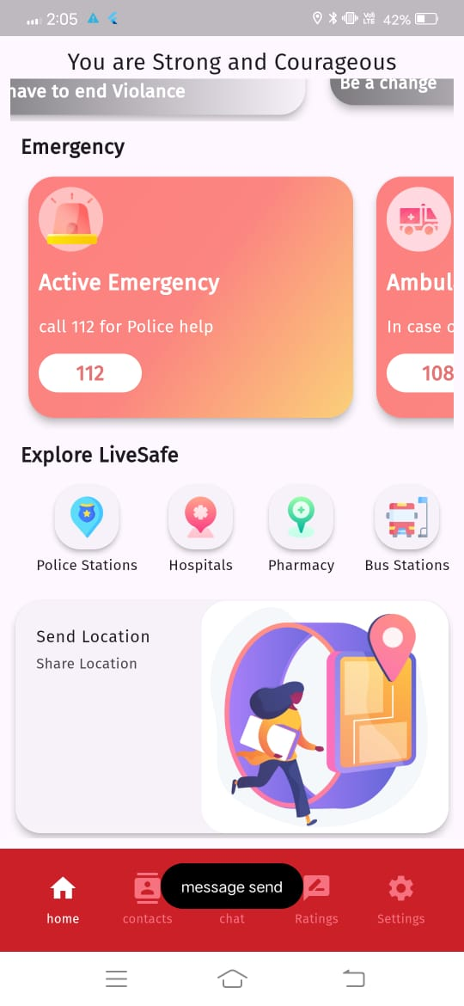
Functionality without internet
The app's critical features, such as generating alerts and accessing safety information, remain functional offline, ensuring users remain protected in low connectivity areas.

Slide 18
06
Training Tutorial

Slide 19
Safety tips and advice
The tutorial includes essential safety tips, covering how to assess personal risks and respond appropriately during various emergency situations, empowering users.

Slide 20
Conclusions
The integration of advanced features such as SOS alerts, offline functionality, and user training not only enhances the effectiveness of the women security system but also empowers women to feel safer and more secure in their everyday lives.

Slide 21
Thank You

